Slide 1
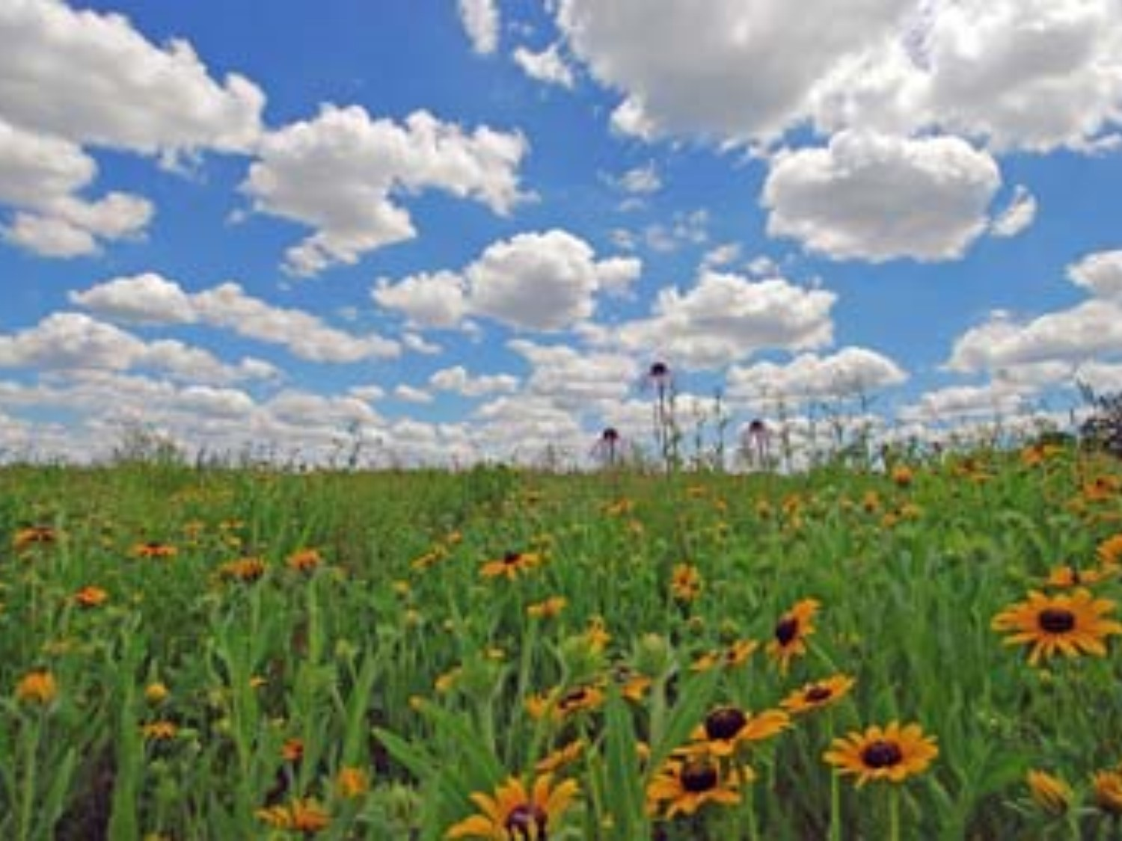
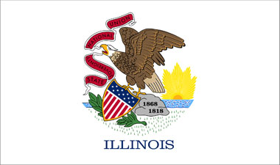
History of Illinois

Slide 2
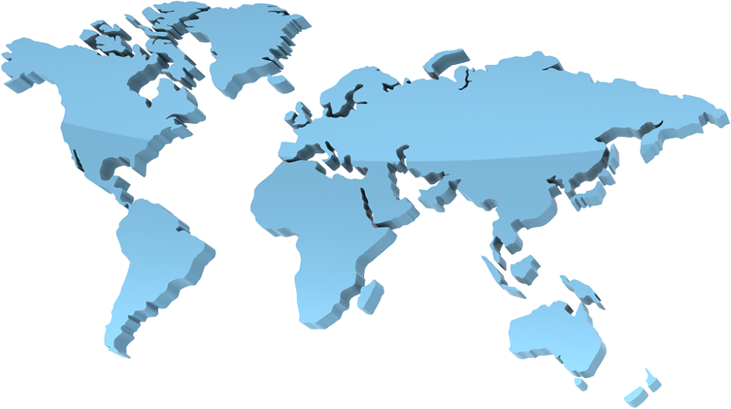
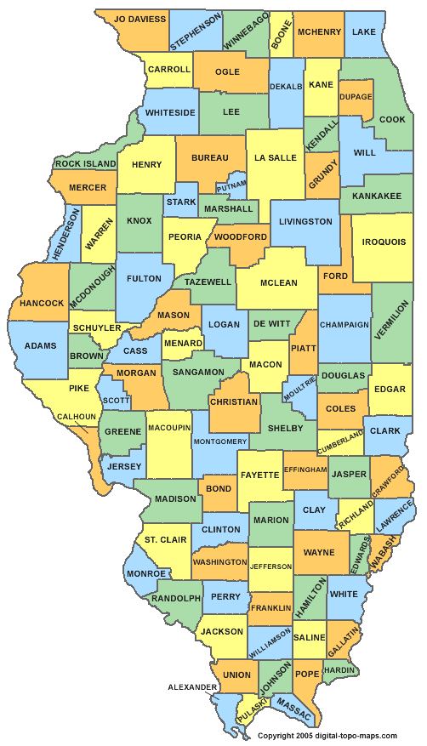
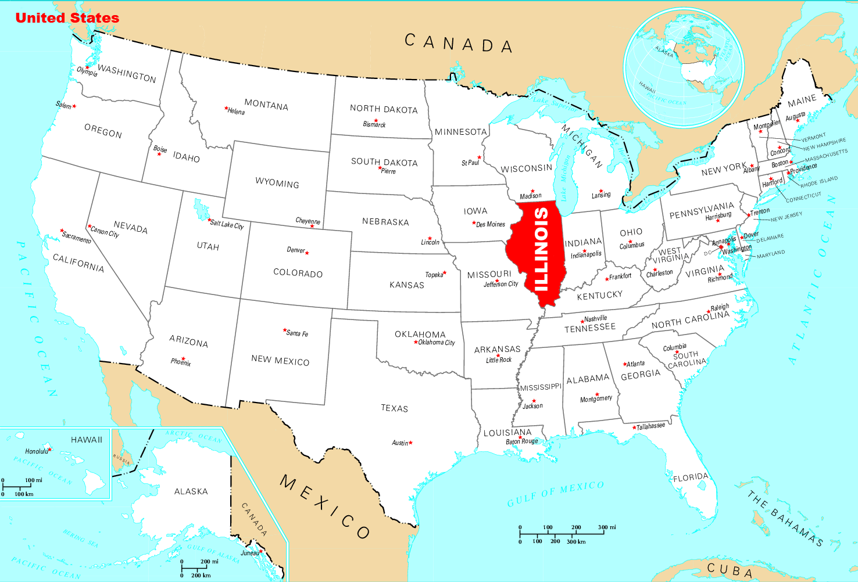
Where in the world are we?
USA
Where is our county?
Illinois
Illinois

Slide 3
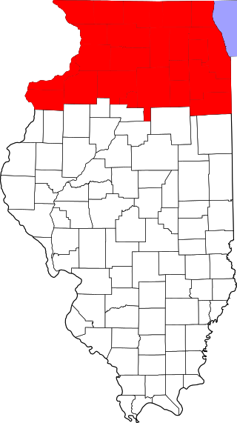
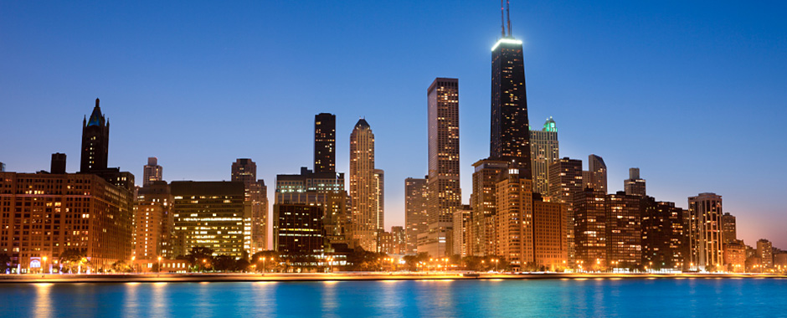
Our state has three regions
Northern Illinois contains over 75% of the state’s population. Chicago is located here.

Slide 4
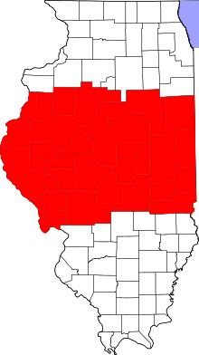
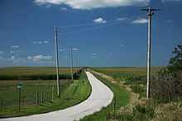
Our state has three regions
Central Illinois is mostly a flat prairie. Douglas county is the state’s flattest area. Principal crops in central Illinois are corn and soybeans.

Slide 5
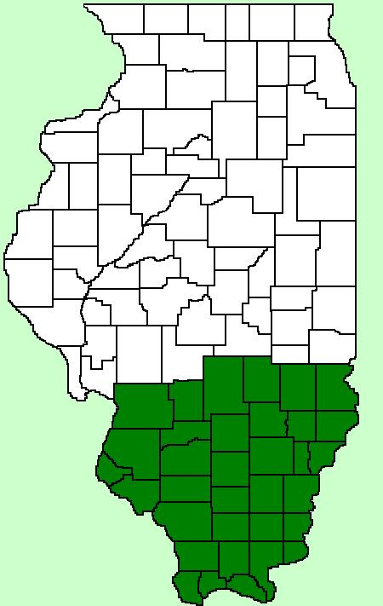
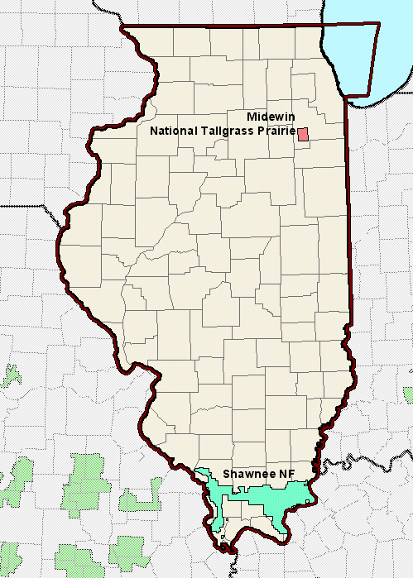
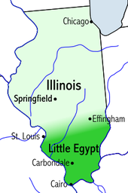

Our state has three regions
Shawnee National Forest was designated as a protected area by President Franklin D. Roosevelt in September 1939. 132,000 years ago, the Laurentide ice sheet covered up to 85% of Illinois and extended down into the Shawnee National Forest, pushing rocks in its path.
Southern Illinois is also known as “Little Egypt.” There are two theories on how this area became known as Little Egypt. The first refers to Egyptian place names such as Cairo and Thebes. The second theory says the region got its name because settlers in their wagon trains were similar to the ancient Israelites traveling into Egypt.
Notes:
TEACHERS: Please “play” the PowerPoint to see how the overlaid wording works to increase interest for your students!

Slide 6
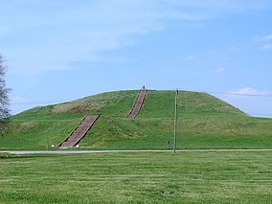
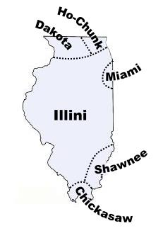
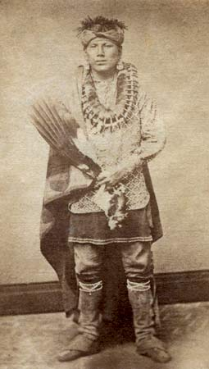
Native Americans in Illinois
Cahokia Mounds State Historic Site is located on the site of a pre-Columbian Native American city. It was located near present day Collinsville, Illinois. That civilization vanished around 1400–1500 for unknown reasons.
The next Native American group in the region was the Illiniwek Confederation. It was a political alliance among several tribes. Pictured is a member of the Peoria tribe from the Illiniwek Confederation in the 1880s.
Click the map to see a brief video about the Illiniwek Confederation

Slide 7
Native Americans in Illinois
Cahokia Mounds State Historic Site is located on the site of a pre-Columbian Native American city. It was located near present day Collinsville, Illinois. That civilization vanished around 1400–1500 for unknown reasons.
The next Native American group in the region was the Illiniwek Confederation. It was a political alliance among several tribes. Pictured is a member of the Peoria tribe from the Illiniwek Confederation in the 1880s.

Slide 8
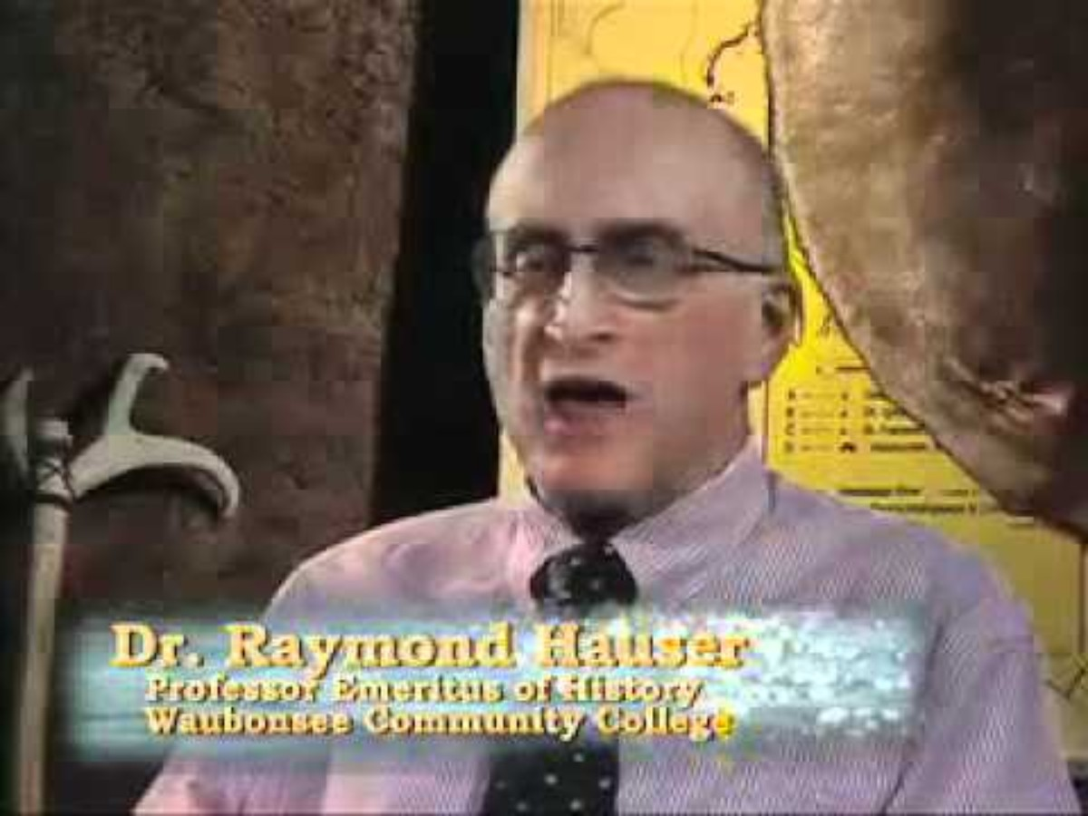

Slide 9
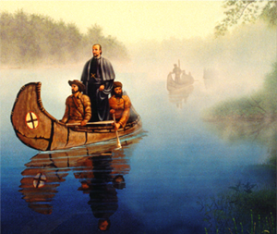
Early Settlers in Illinois
In 1673, Father Jacques Marquette and Louis Jolliet began exploring the shores of Peoria.
“At 42 and a half degrees Of latitude, We safely entered Mississippi on The I7th of June, with a Joy that I cannot Express.”
— Jacques Marquette, 1674
“There are prairies … surrounded by forests …beyond these, the prairies begin again, so that there is as much of one sort of land as the other. Sometimes we saw the grass very short, and, at other times, five or six feet high.”
— Louis Jolliet, 1674

Slide 10
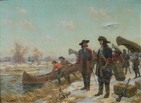
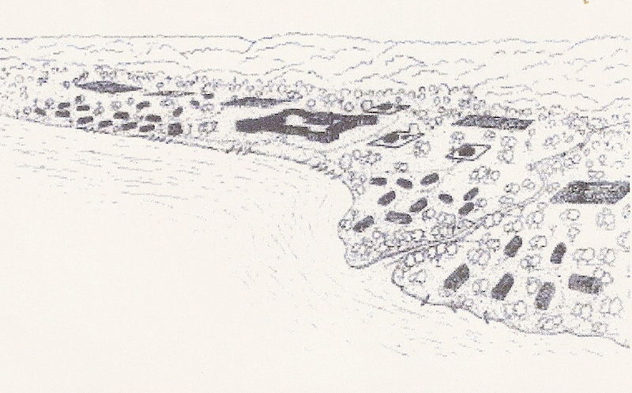
Early Settlers in Illinois
In 1680, Robert Cavalier Sieur de LaSalle and Henri de Tonti constructed Fort Crevecoeur on the east bank of the Illinois River near present day Peoria.
Henri de Tonti and Francois Daupin de LaForest built Fort St. Louis II (frequently called Fort Pimiteoui) believed to have been located at the foot of Mary and Adams Streets. A village grew up around the fort. This first European settlement in Illinois had trading posts, a blacksmith shop, a chapel, a winepress, and a windmill.
With British victory in the French & Indian War in 1763, France relinquished the Illinois Territory to Great Britain. In 1778 George Rogers Clark captured the Illinois Region for Virginia, and in 1784 Virginia ceded the Territory to the United States.

Slide 11
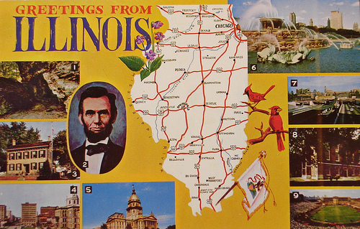
Click the postcard to hear the state song, Illinois, and see images of the University of Illinois

Slide 12
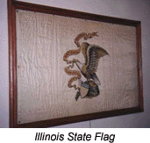
Our State Flag
The Illinois state flag has an interesting history. The original flag was adopted in 1915. The Illinois Daughters of the American Revolution sponsored a contest and this was the design that won:
Over fifty years later, Chief Petty Officer Bruce McDaniel of Waverly, wanted something added to the flag. The Illinois flag was one of many state flags that were hung on the walls of his mess hall. However, nobody knew which flag it was. So McDaniel requested that the flag carry the state’s name. This was approved on September 17, 1969. This authorized a new flag to carry the word “Illinois”.
The Bald Eagle represents the United States and holds a red streamer in its beak. On it is written the state motto, "State sovereignty, national union.” In the Bald Eagle's talons is a shield with thirteen bars and thirteen stars representing the original thirteen colonies. The date Illinois was admitted to the Union and the date of the State seal are printed on the boulder. The ground around the boulder symbolizes the rich soil of this Prairie State.
Notes:
Information from http://www.statesymbolsusa.org/Illinois/flag_TN.html

Slide 13
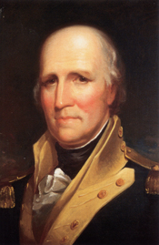
Illinois during the Revolutionary War
During the Illinois campaign from 1775-1783, a small force of militiamen led by George Rogers Clark seized control of several British posts in the Illinois country. The campaign is the best-known action of the western theater of the war. It is the reason for Clark's reputation as an early American military hero.
The importance of the Illinois campaign has been the subject of much debate. The British ceded the entire Northwest Territory to the United States in the 1783 Treaty of Paris. However, some historians have credited Clark with nearly doubling the size of the original Thirteen Colonies by seizing control of the Illinois country during the war.

Slide 14
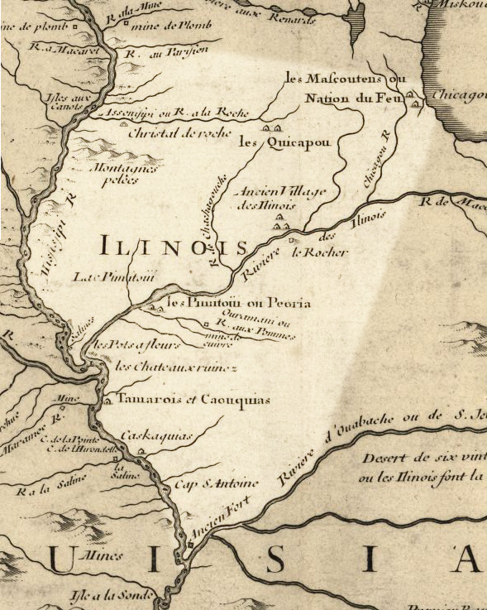
Statehood
As Illinois grew, it became more important to the United States. In 1809, the Illinois Territory was created with its own governor and capital city in Kaskaskia.
In 1811 the first coal mine opened
In 1813 land offices opened in Kaskaskia and Shawneetown.
In 1814 Matthew Duncan started the Illinois Herald, the first newspaper in Illinois.
By 1818, almost 35,000 people lived in the Illinois Territory. Many Illinoisans at this time earned their living by trapping animals and selling the fur.

Slide 15
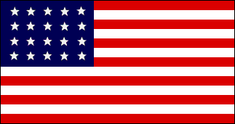

Statehood
In April 1818 Congress passed a law called the Illinois Enabling Act. This law allowed the Illinois Territory to prepare for statehood.
In July 1818 voters chose 32 delegates to create the first Illinois State Constitution.
On December 3,1818 President James Monroe signed the law that Made Illinois the twenty-first state of the United States

Slide 16
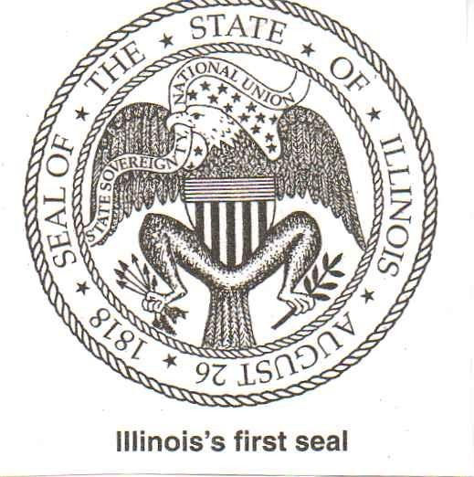
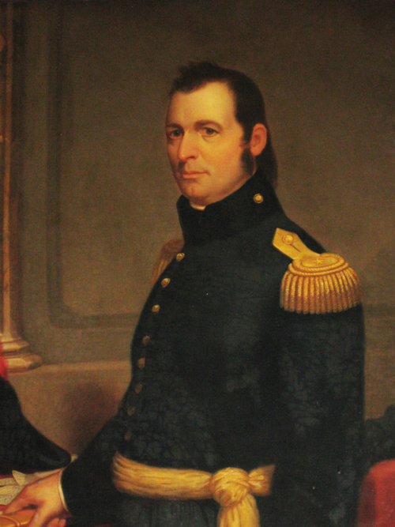
First State Government
Shadrach Bond was elected as the first governor of Illinois. Bond was one of the founders of the city of Cairo.
Kaskaskia in western Illinois became the first state capital of the new state of Illinois.
Illinois chose a seal showing an eagle holding arrows and an olive branch in its claws. These are symbols of war and peace
In May 1819 workers began building the capital city of Vandalia.

Slide 17
Vandalia
The first Vandalia capitol building was small and had only two floors.
The first Vandalia capitol building burned down in December 1823. A second capitol was built the next year. It was not constructed well and some people refused to enter it.
The citizens of Vandalia built a third building that was large enough to hold offices for most of the state officials.
In 1839 the people chose to move the capitol to Springfield.

Slide 18
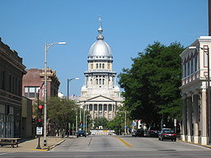
Our state capitol: Springfield
How much do you know?
The most famous past resident is _________ ____________, who lived in Springfield from 1837 until 1861.
Abraham
Lincoln
Springfield's original name was ___________.
Calhoun
1820
The settlement's first cabin was built in _______, by John Kelly.
Sangamon
Springfield lies near the _______________River Valley.
Lake
Springfield
________ _______________ supplies the city with drinking water.
Central
Springfield is located in ______________ Illinois.

Slide 19
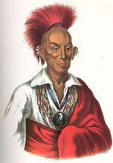
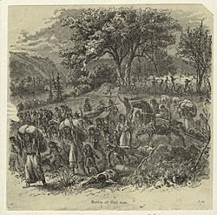
Black Hawk War
As more and more settlers moved into Illinois, Native American tribes were forced to move farther west. Some of the tribes decided they wanted their land back.
In 1832, a group of Indians led by Sauk chief Black Hawk returned to Illinois to take their land back.
Black Hawk and his warriors were defeated by the U.S. army at the Battle of Bad Axe and were forced to move back to Iowa.
Native women and children fleeing the Battle of Bad Axe during the Black Hawk War.

Slide 20
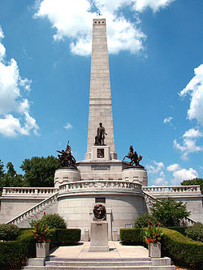
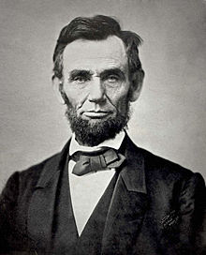
Abraham Lincoln
Abraham Lincoln was the 16th president of the United States, serving from March 1861 until his assassination in April 1865.

Slide 21
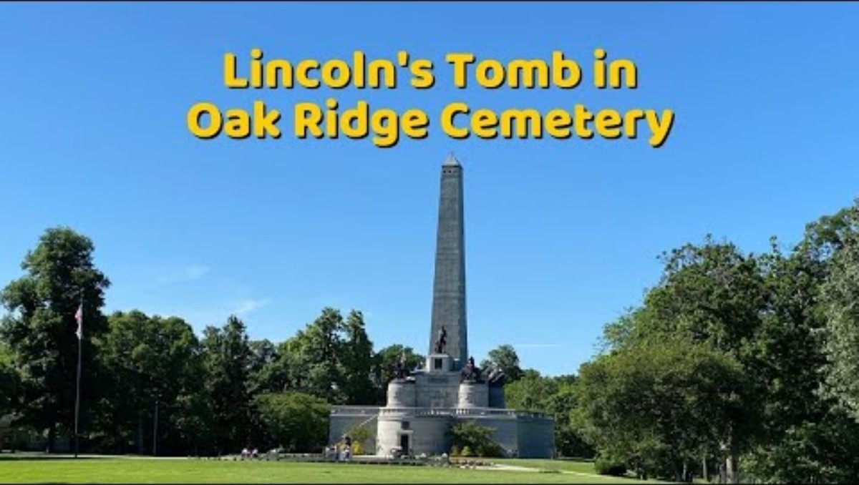

Slide 22
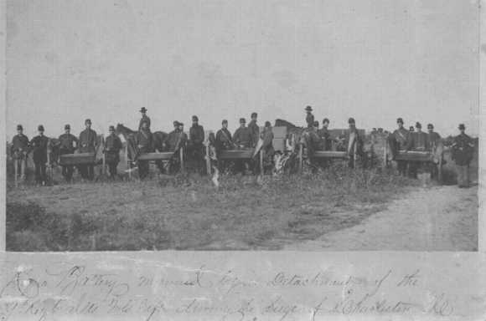
Illinois in the Civil War
Illinois stayed loyal to the Union during the Civil War. Even though there were no major battles in Illinois, over 250,000 men from Illinois served as soldiers in the Union Army. The war ended in 1865 with the surrender of the Confederate Army.
Picture of Regimental Battery manned by a detachment of the 39th Regiment Illinois Volunteers during the Siege of Charleston, South Carolina – Summer 1863.

Slide 23
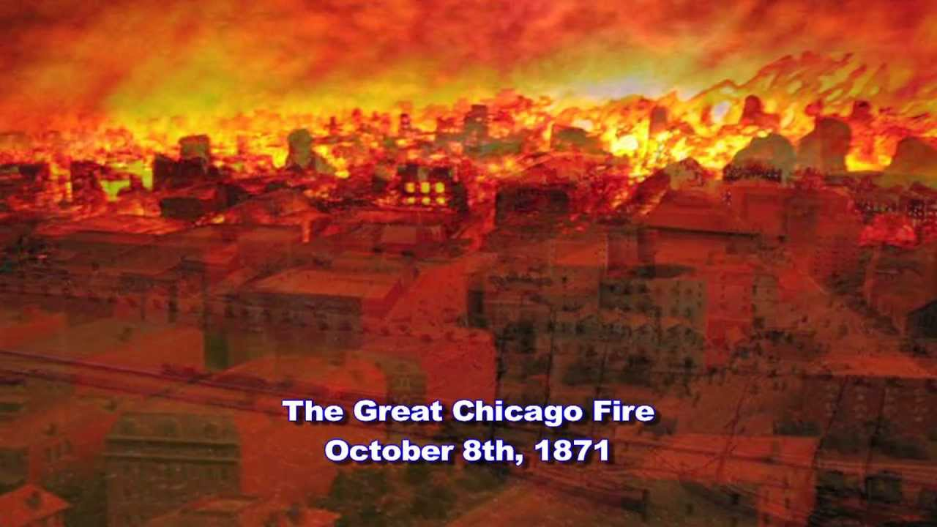
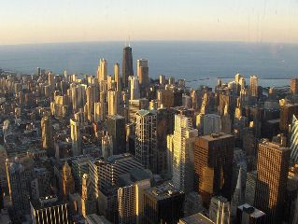
Chicago Fire!
One of the worst fire disasters in the history of the United States took place in Chicago on October 8, 1871. It all started with a small fire in O’Leary’s barn in south Chicago. Most of the buildings in those days were made of wood and once the fire got going it was tough to stop. Over 20,000 buildings were completely destroyed. The fire left close to 100,000 inhabitants homeless and killed between 200 and 300 people.
Chicago today
Why would a city-wide fire be less likely today?

Slide 24
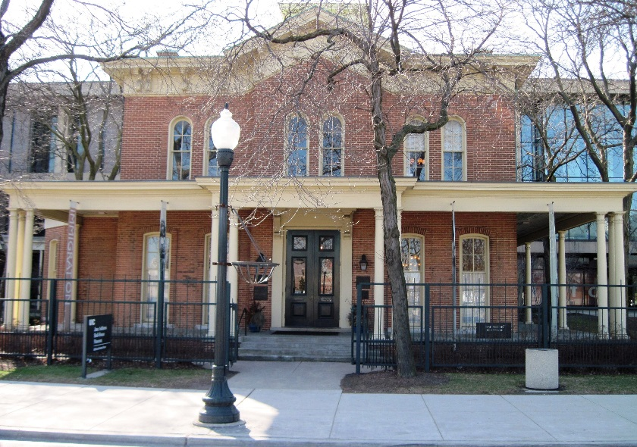
Hull House
In 1889, Jane Addams opened Hull House in Chicago to help recently-arrived immigrants.
This is what she did:
For children: Day care, kindergarten, game room, gymnasium, after-school activities
For women: Cooking classes, dances, citizenship preparation classes, language classes
AND MUCH, MUCH MORE!

Slide 25
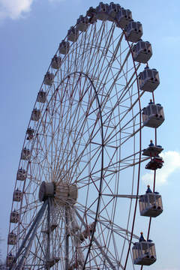
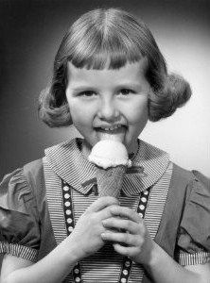
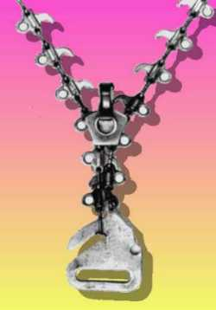
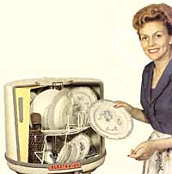
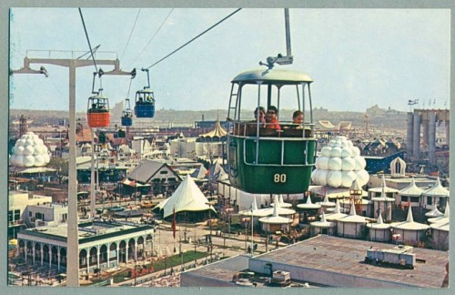
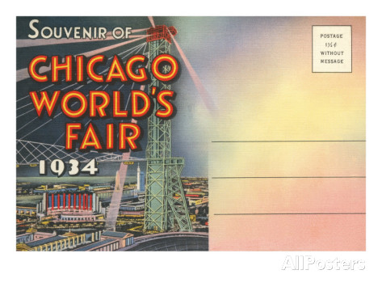
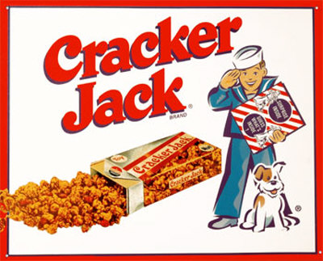
The World’s Columbian Exposition
This was a World's Fair held in Chicago in 1893 to celebrate the 400th anniversary of Christopher Columbus' arrival in the New World in 1492. Which one of the pictured images was NOT introduced at that World’s Fair?
1964 World’s Fair
(picture postcard)

Slide 26
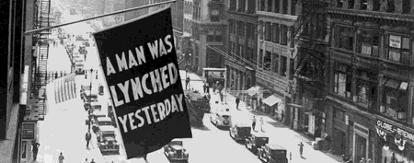
The NAACP started in Springfield
On August 14, 1908, two black men were accused of separate crimes against white men.
An angry mob gathered outside of the city jail to seek revenge.
In the violent riot that ensued, buildings were destroyed and looted. Two unrelated black members of the community were lynched. The appalling event led to the formation of the National Association for the Advancement of Colored People (NAACP) a few months later.

Slide 27


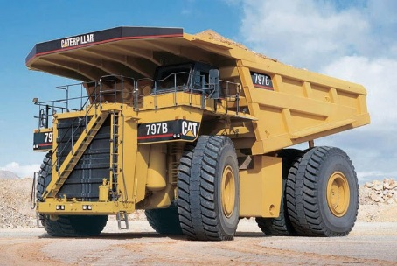


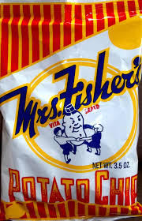
Many companies began in Illinois
1955 - McDonald's Corporation is founded in Des Plaines
1837 – John Deere opened a plant in Grand Detour
1910 - Caterpillar opened up a plant in East Peoria
1922 – State Farm Insurance is founded in Bloomington
1932 – Mrs. Fisher began making potato chips in Rockford
1916 – Ideal Industries is founded in Chicago, Illinois

Slide 28
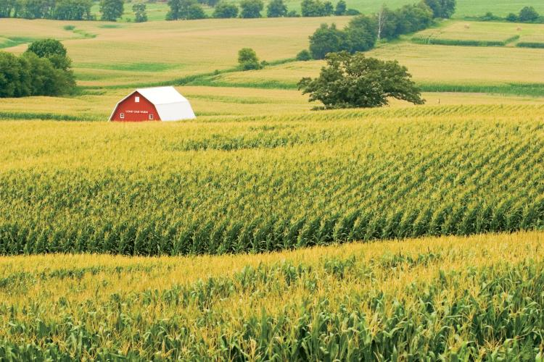
Illinois Agriculture
Click the image of the farm to see a video about IL Agriculture

Slide 29
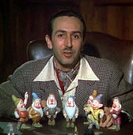
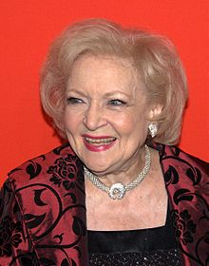
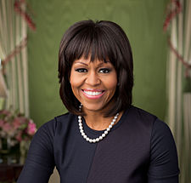





Some Famous People from Illinois – Can you name them?
Do you know any others?
Walt Disney, Chicago
Betty White, Oak Park
Michelle Obama, Chicago
Harrison Ford, Chicago
Hillary Clinton, Chicago
Jane Lynch, Dolton
Jack Benny, Chicago
Cindy Crawford, DeKalb

Slide 30

Illinois Symbols Quiz…
What is the Illinois state flower?
Mountain Laurel
Purple violet
Cherokee rose
Bluebonnet
In 1907 Illinois schoolchildren voted to select the violet as the state flower. There are eight different species of violets in Illinois.

Slide 31

Illinois Symbols Quiz…
What is the Illinois state bird?
Eastern goldfinch
Mountain blue bird
Northern cardinal
Wild Turkey
Male cardinals are a brilliant scarlet red, females a buffy brown with reddish wings - both have a jet -black mask, pronounced crest, and heavy bill. The cardinal sings nearly year-round.

Slide 32

Illinois Symbols Quiz…
What is the Illinois state wild animal?
White tailed deer
Moose
Black bear
Gray squirrel
The white-tailed deer is an animal of incredible beauty and power; they are able to run up to 40 miles per hour, jump 9 foot fences, and swim 13 miles per hour.

Slide 33

Illinois Symbols Quiz…
What is the Illinois state butterfly?
Monarch butterfly
Tiger Swallowtail
Viceroy Butterfly
Karner Blue Butterfly
Both the caterpillar and adult monarch butterfly are brilliant in color as a warning to predators - the monarch ingests toxins from the milkweed plant which are poisonous.

Slide 34

Illinois Symbols Quiz …
What is the Illinois state tree?
Blue spruce
Loblolly pine
White oak
Candlenut tree
Illinois designated the white oak the official state tree in 1973, the result of a special poll of 900,000 school children. The state tree had previously been the native oak (adopted in 1908), but there are many species of "native oak" in the state of Illinois, and no particular one had been specified.

Slide 35

Illinois Symbols Quiz …
What is the Illinois state amphibian?
Red hills salamander
Wood frog
Bullfrog
Eastern tiger salamander
Illinois designated the eastern tiger salamander as the official state amphibian in 2005 after winning the vote of the citizens of Illinois in 2004.
35

Slide 36

Illinois Symbols Quiz …
What is the Illinois state mineral?
Fluorite
Gold
Copper
Agate
Illinois is the largest producer of fluorite in the United States. The most important deposits are located in southern Illinois at Rosiclare and Cave-in-Rock. It is used to make hydrofluoric acid for pottery, optics, and plastics.

Slide 37

Illinois Symbols Quiz …
What is the Illinois state dance?
Hula
Polka
Square dance
Lindy hop
A uniquely American dance, the square dance provided pioneers with recreation and social contact with neighbors - and is still doing that today.

Slide 38

Illinois Symbols Quiz…
What is the Illinois state fish?
King salmon
Channel catfish
Bluegill
Small mouth bass
A member of the sunfish family, bluegill are found throughout Illinois. Bluegills can be recognized by their stripy olive to yellow colors and the distinctive black spot behind its gills.

Slide 39

Illinois Symbols Quiz …
What is the Illinois state fruit?
Avocado
Orange
Blackberry
Goldrush apple
Goldrush apples are a cross of golden delicious and an experimental variety of apple developed by the disease-resistant apple breeding program of the University of Illinois.

Slide 40

Click on the Illinois state quarter for a video review about Illinois

